Slide 1



Yad2 App Mobile
Testing Project
Benny Feigin - Elina Ein Eli - Natan Koren

Slide 2
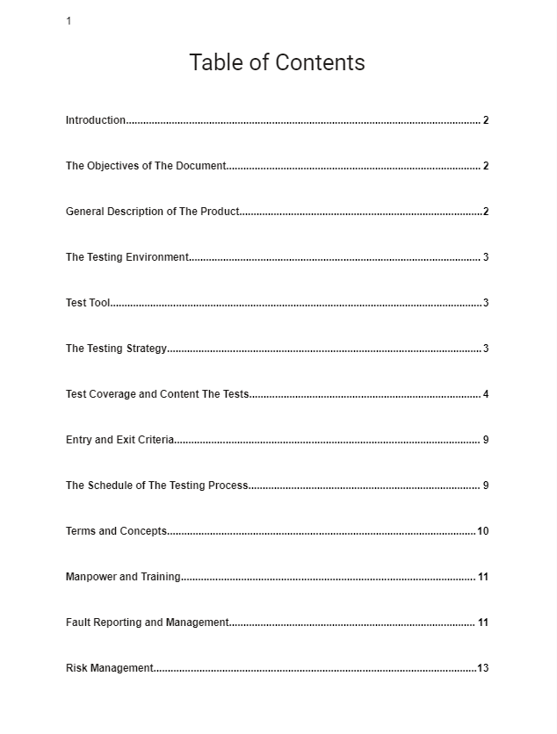



Link to STP Document

Slide 3
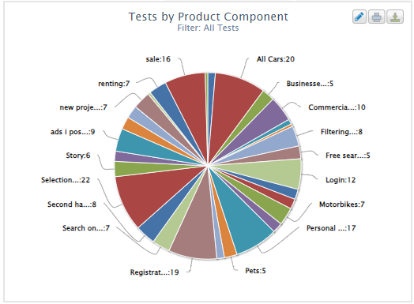


Link to STD Document

Slide 4
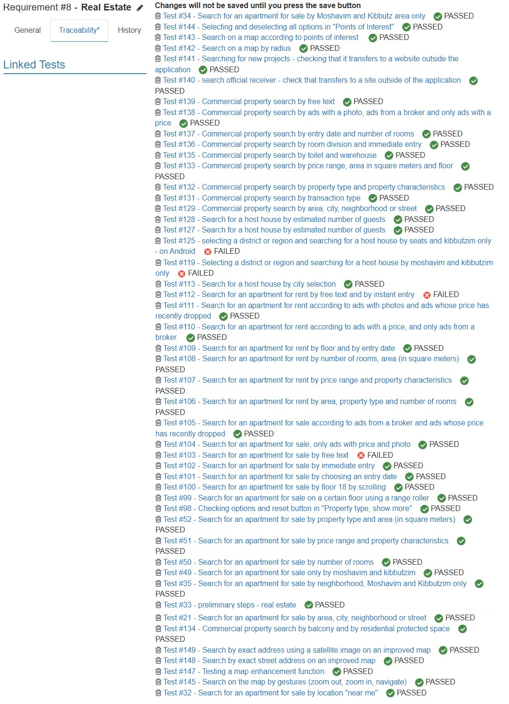

Elina's Test cases related to real estate

Slide 5
Elina Ein Eli test cases
The following test cases will be presented in the following slides:
Test #50 - Search for an apartment for sale by number of rooms
Test #51 - Search for an apartment for sale by price range and property characteristics

Slide 6

Test #50 - Search for an apartment for sale by number of rooms
The description of the test is clearly on the next slide

Slide 7
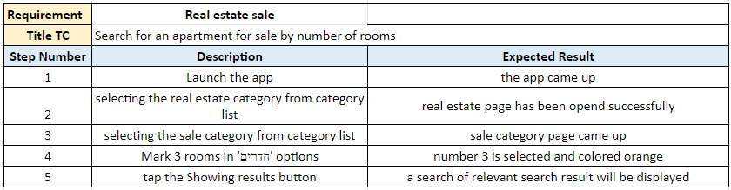
FIRST TEST CASE

Slide 8
Test #51 - Search for an apartment for sale by price range and property characteristics
The description of the test is clearly on the next slide

Slide 9
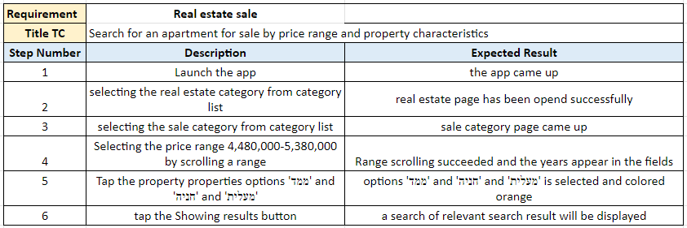
SECOND TEST CASE

Slide 10
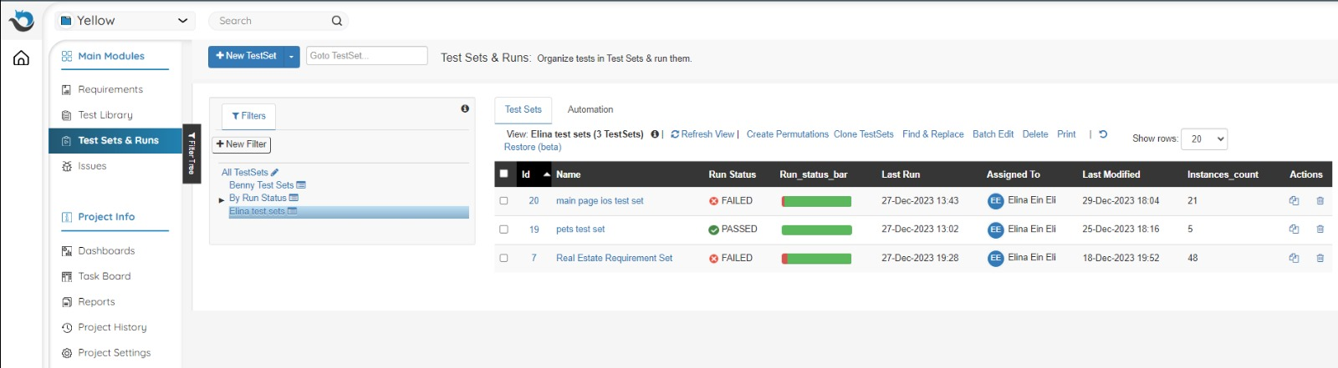
Status Test Runs

Slide 11
Elina Ein Eli Issues
The following Issues will be presented in the following slides:
Issue #14 - real estate- irrelevant result in a free search for an apartment for sale
Issue #16 - real estate- Result of host houses by city instead of by kibbutz and moshav displayed

Slide 12
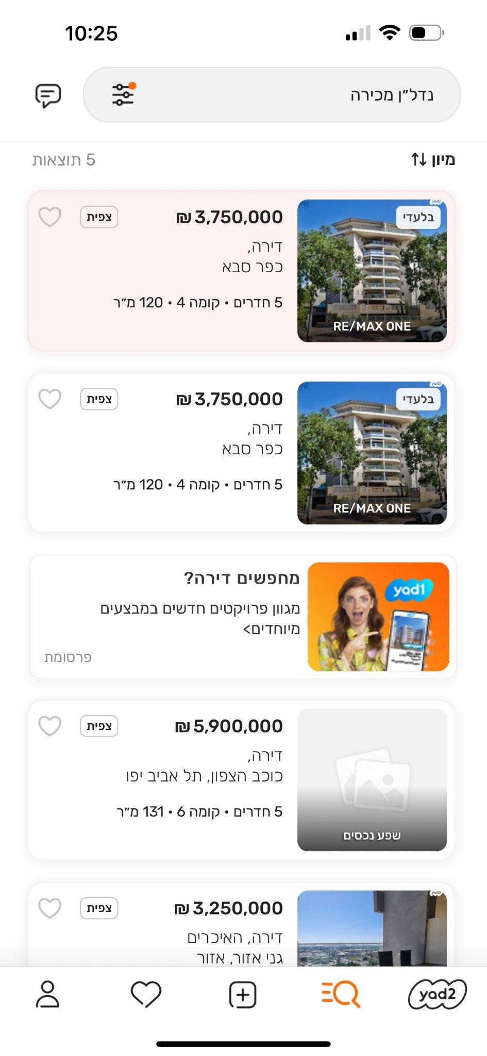
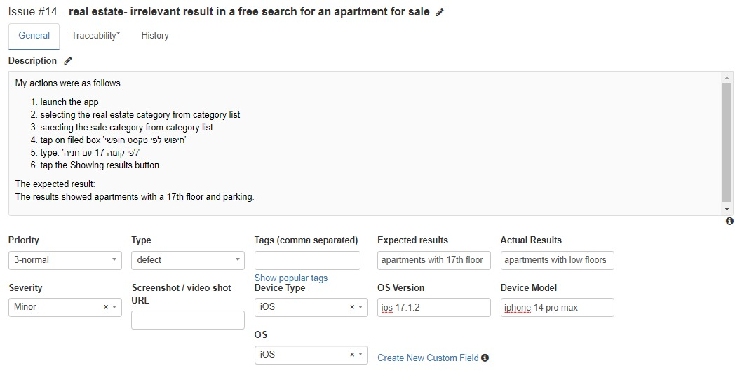
First Issue

Slide 13
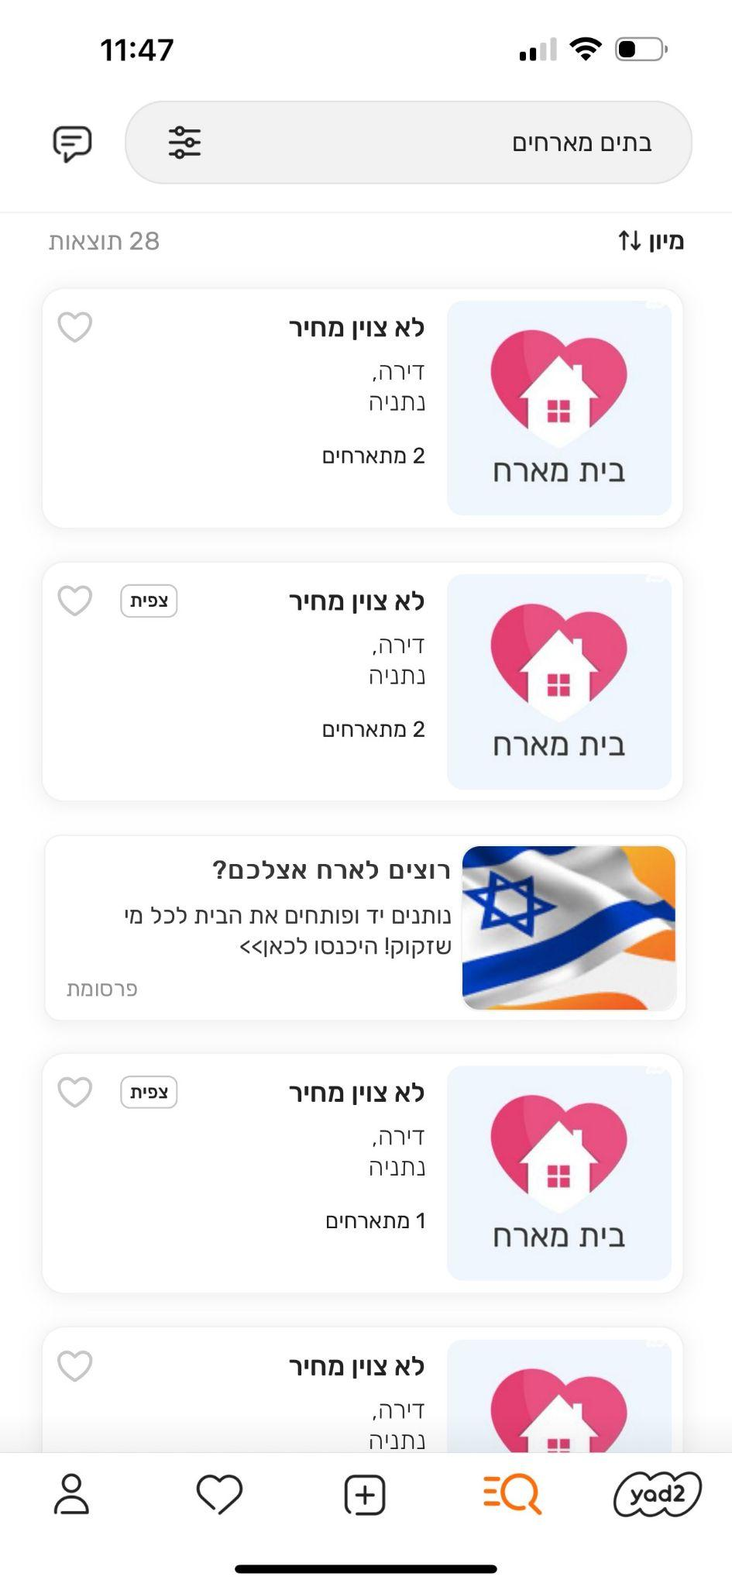
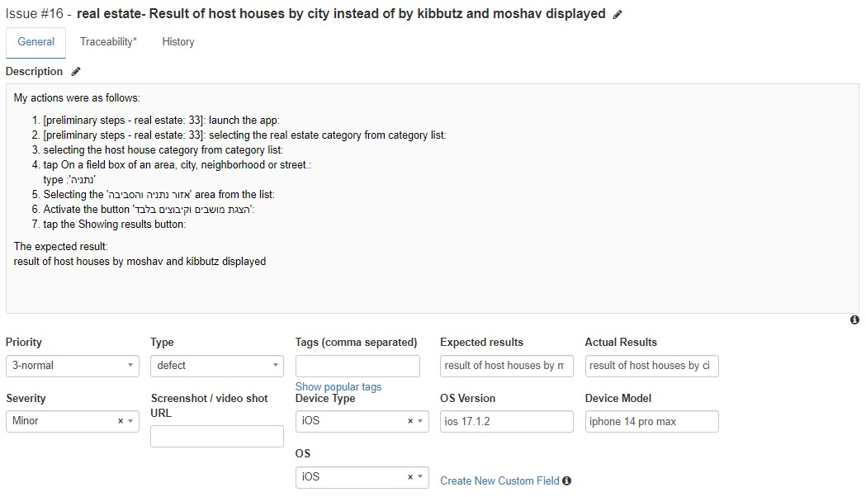
Second Issue

Slide 14
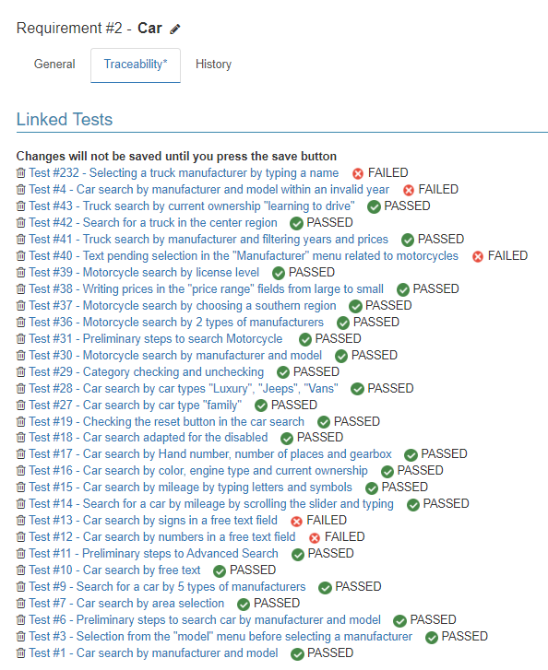
Benny Feigin
Benny's Test Cases related to Car Requirement

Slide 15
Benny Feigin
Benny Feigin Test Cases
The following test cases will be presented in the following slides:
Test #47 - Search for a business for sale by "near me"
Test #1 - Car search by manufacturer and model

Slide 16
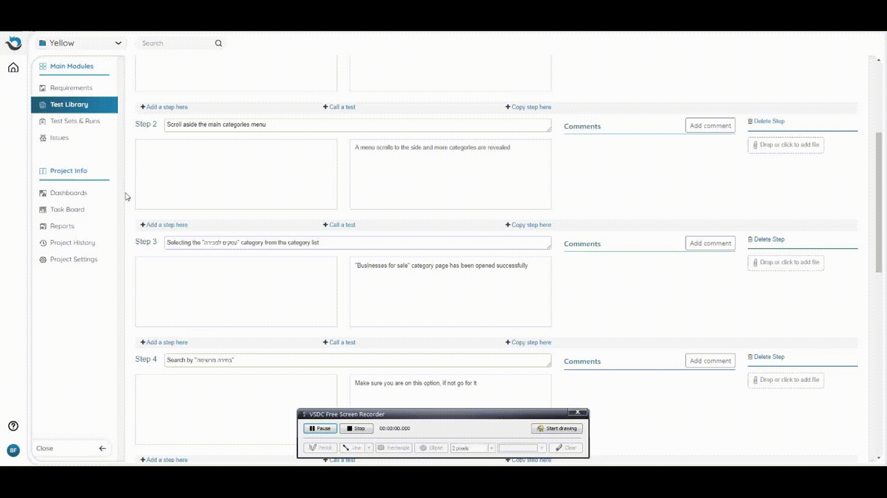
Benny Feigin
Test #47 - Search for a business for sale by "near me"
The description of the test is clearly on the next slide

Slide 17
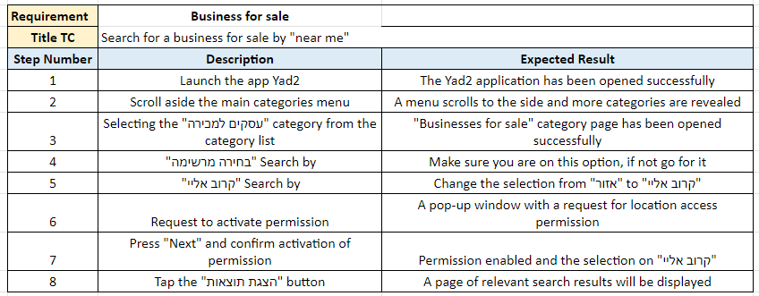
Benny Feigin
FIRST TEST CASE

Slide 18
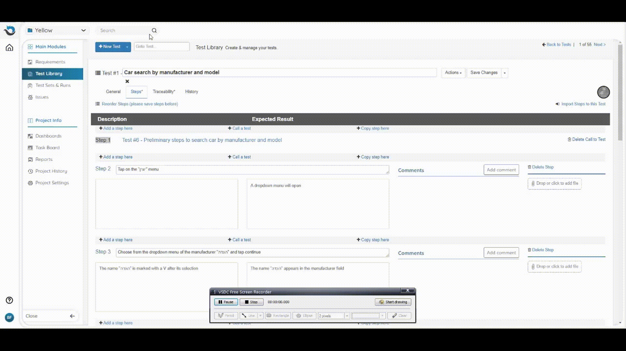
Benny Feigin
Test #1 - Car search by manufacturer and model
The description of the test is clearly on the next slide

Slide 19
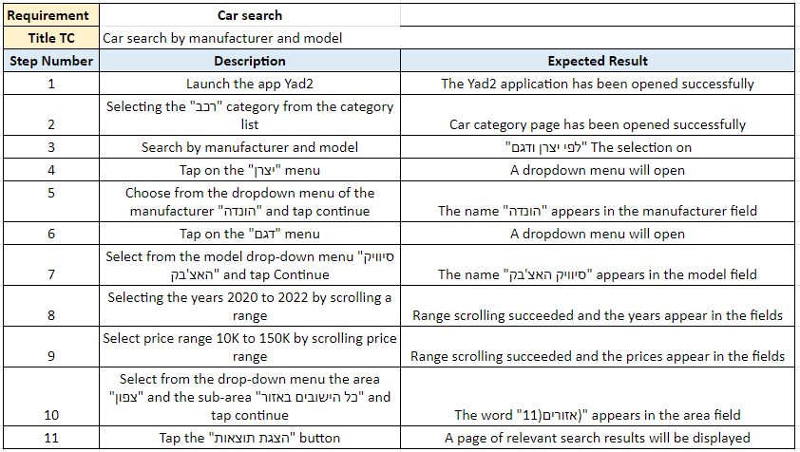
Benny Feigin
SECOND TEST CASE

Slide 20
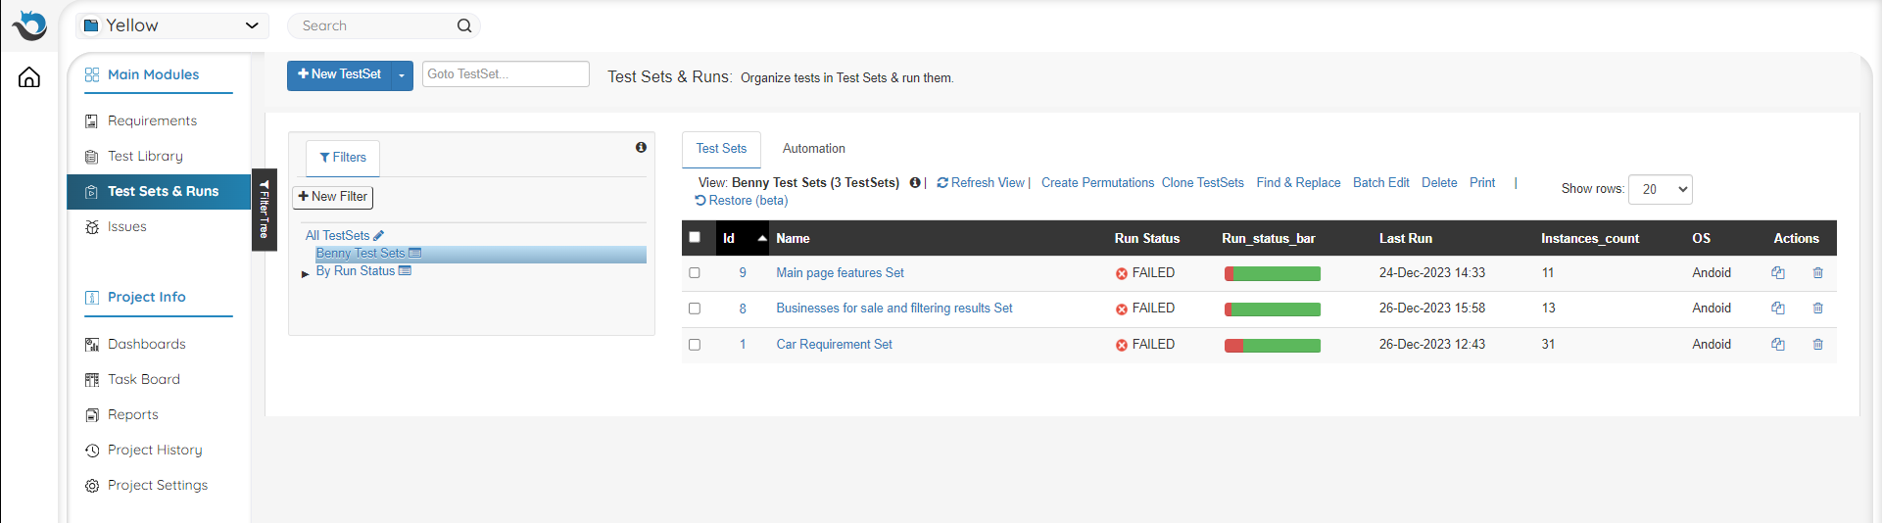
Benny Feigin
Status Test Runs

Slide 21
Benny Feigin
Benny Feigin Issues
The following Issues will be presented in the following slides:
Issue #5 - Car search - No error message when typing symbols in the free search field
Issue #9 - Motorcycle search - Text awaiting manufacturer selection is incorrect

Slide 22

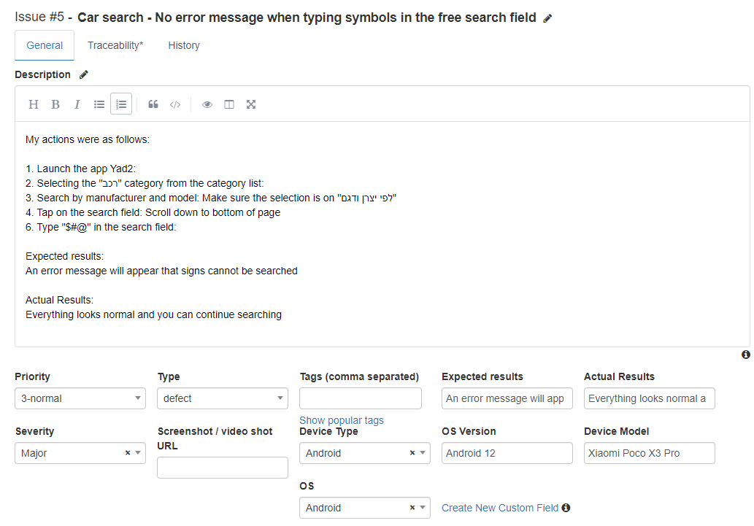
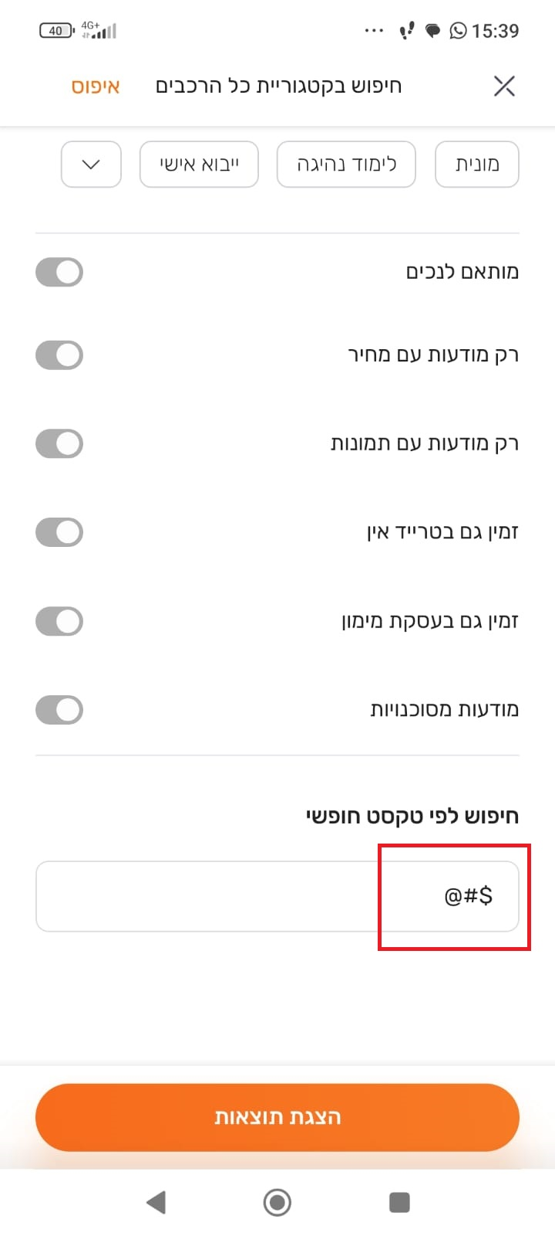
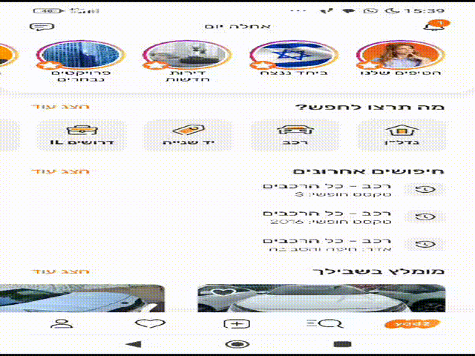
Benny Feigin
First Issue

Slide 23
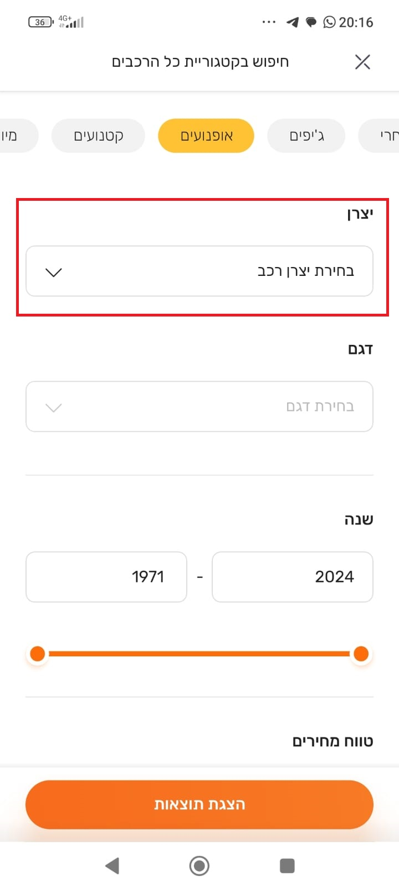
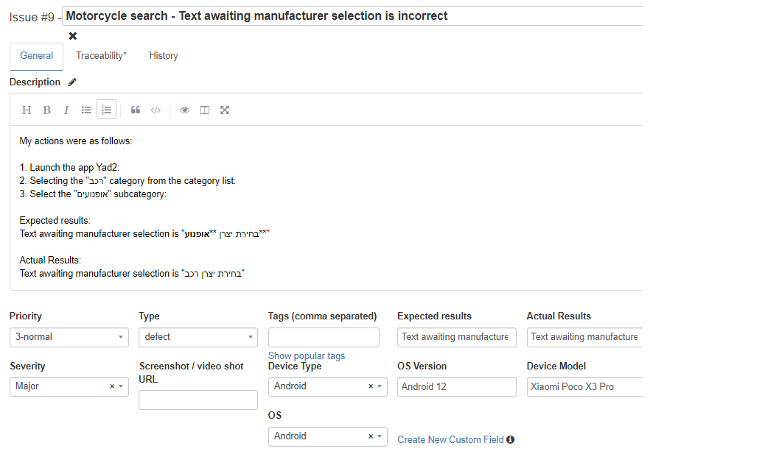
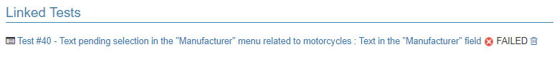
Benny Feigin
Second Issue

Slide 24
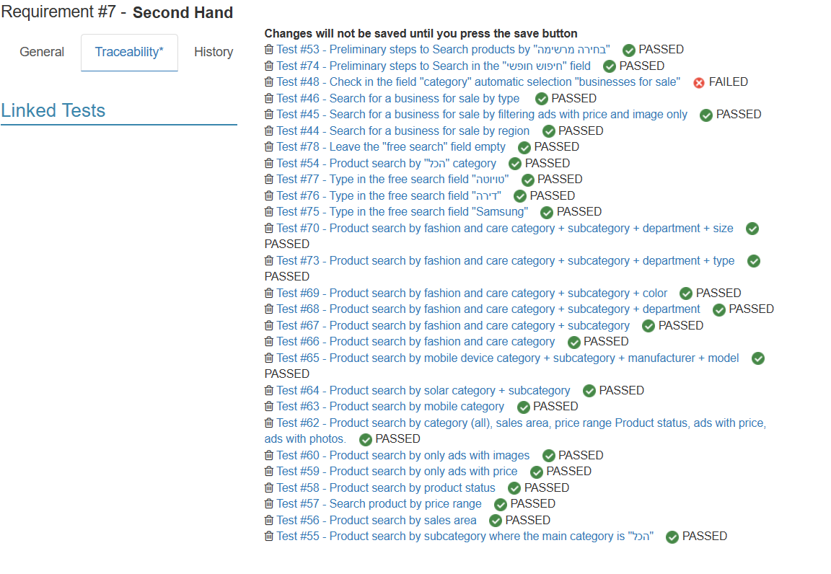
Natan Koren Requirement

Slide 25
Natan Koren test cases
The following test cases will be presented in the following slides:
Test #62 - Product search by category (all), sales area, price range Product status, ads with price, ads with photos.
Test #177 - Successful registration
*The preliminary steps for each test case will be presented*

Slide 26
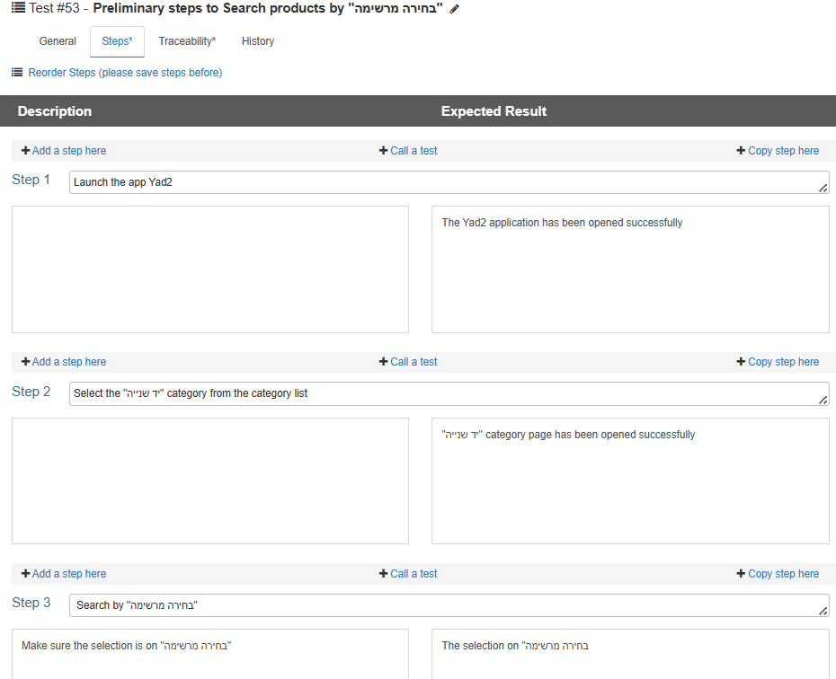
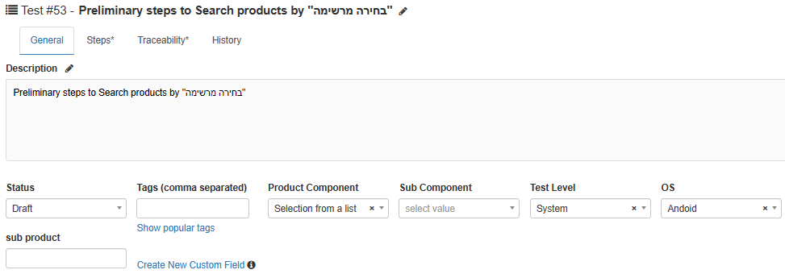
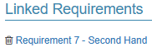
FIRST TEST CASE

Slide 27
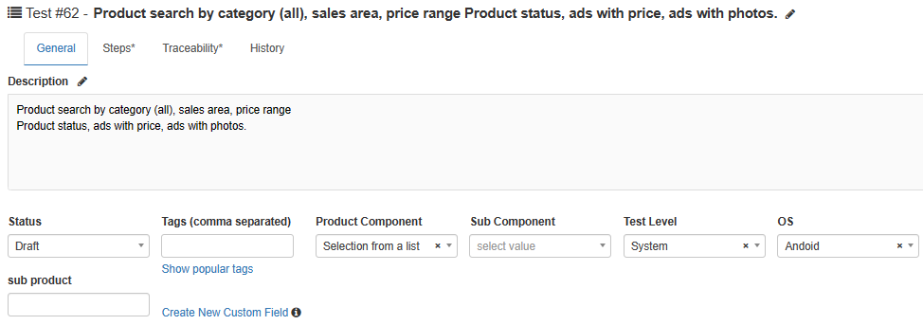
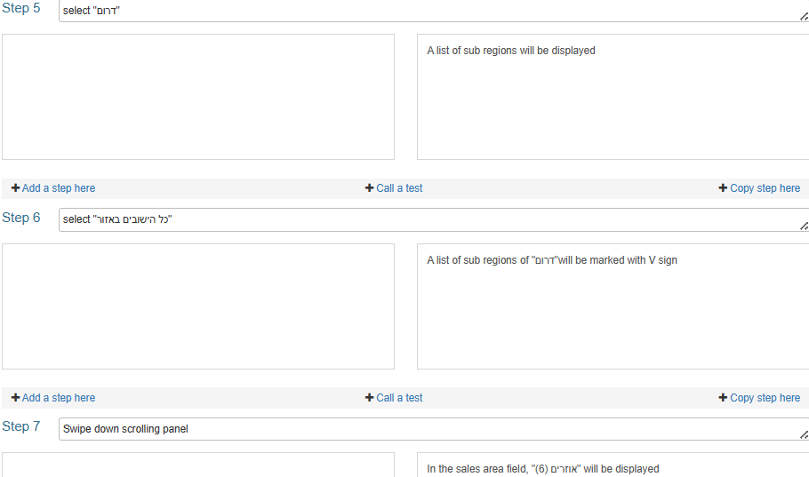
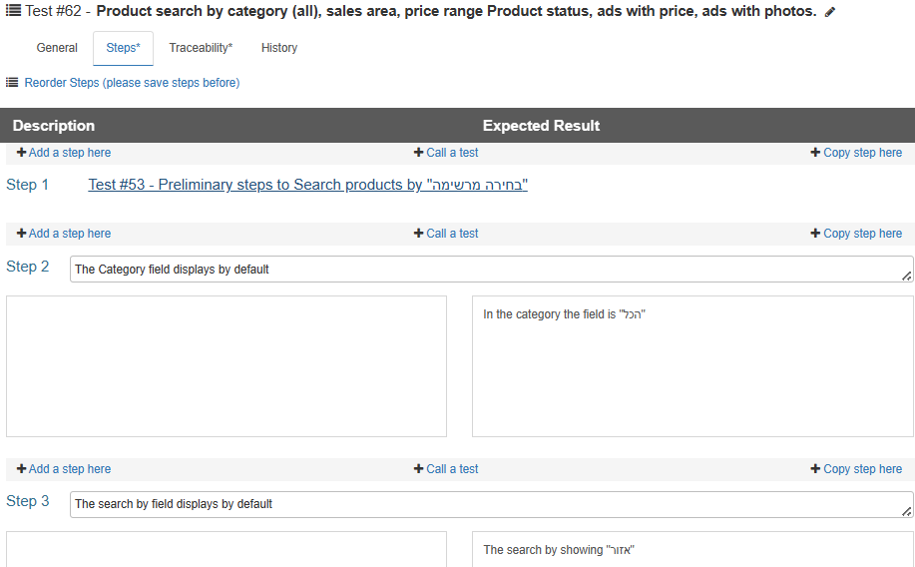
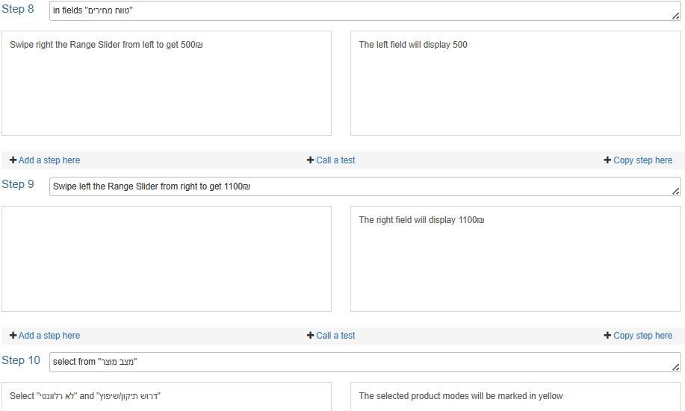
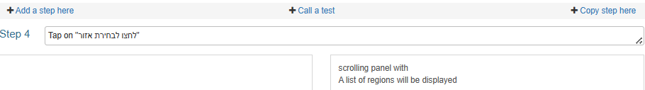

Slide 28
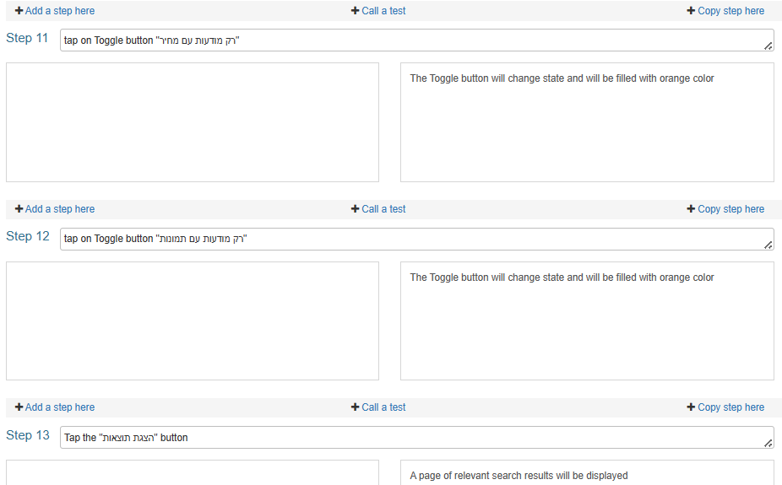

Slide 29
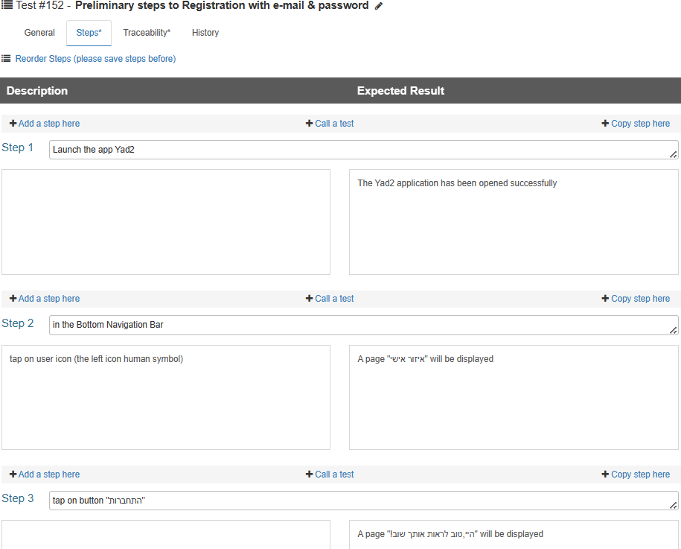
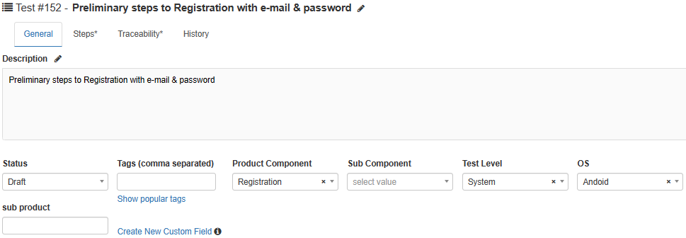
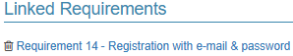
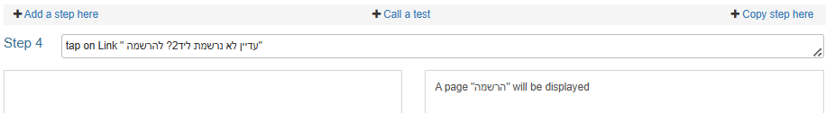
SECOND TEST CASE

Slide 30
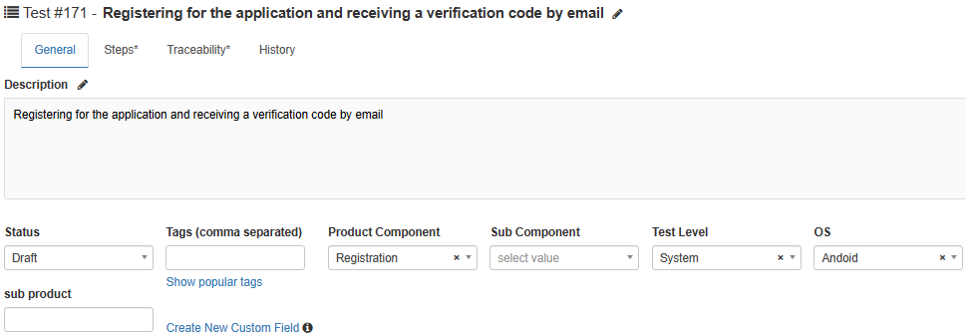
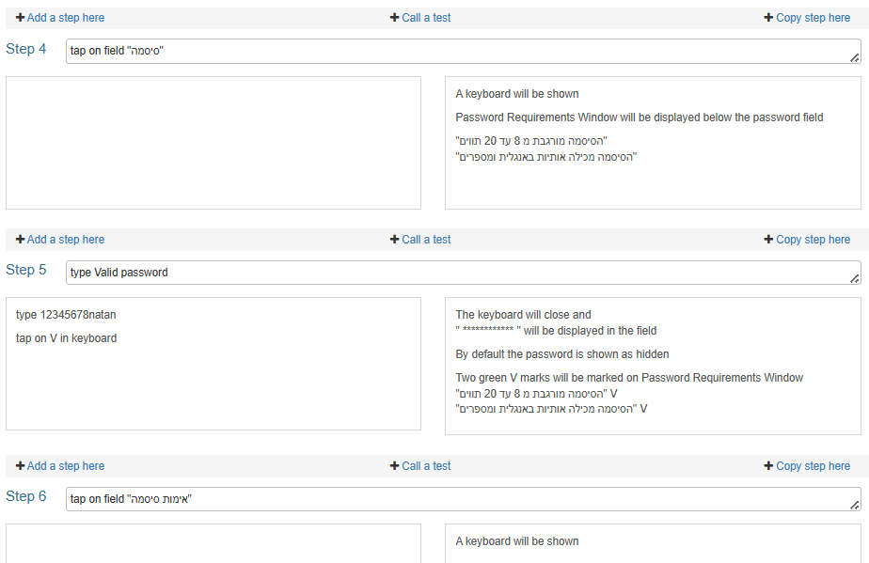
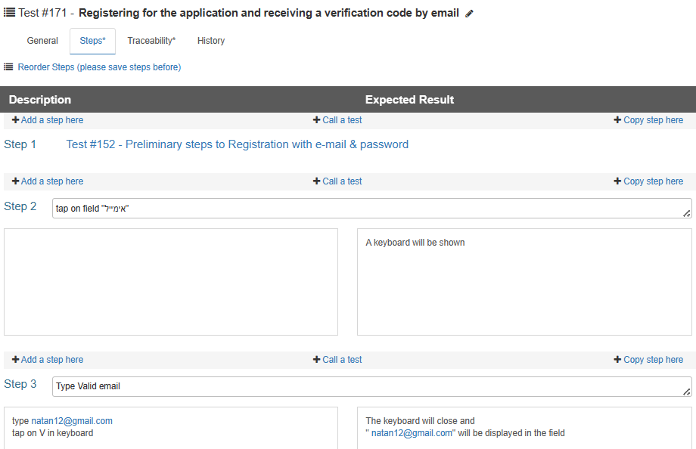
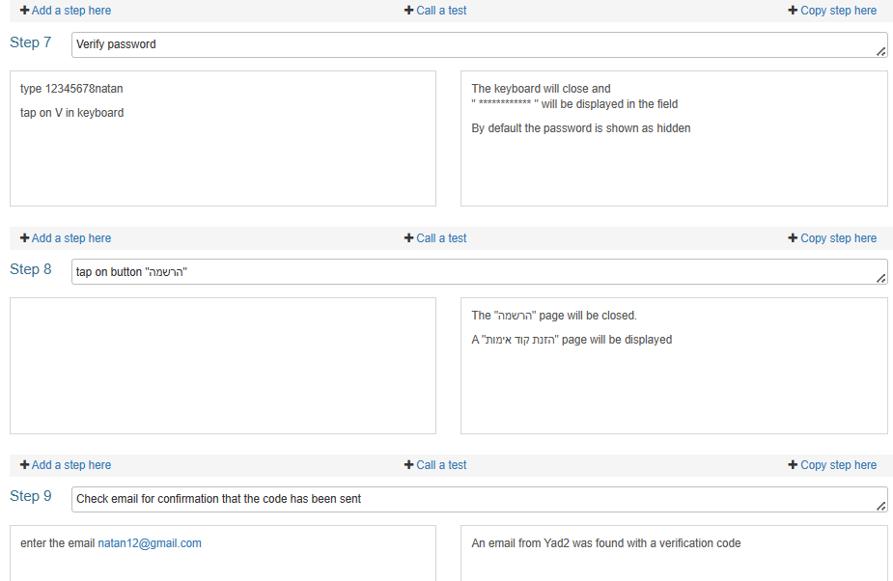

Slide 31
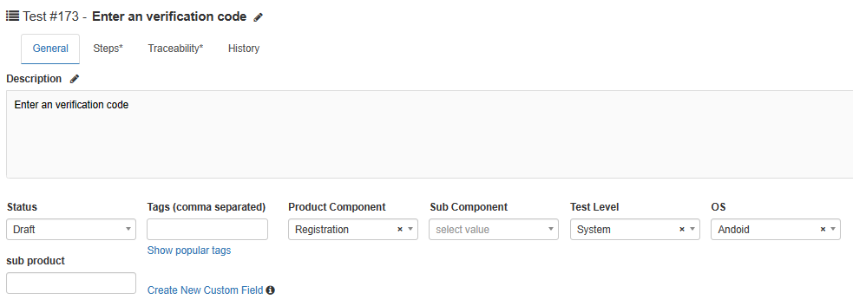
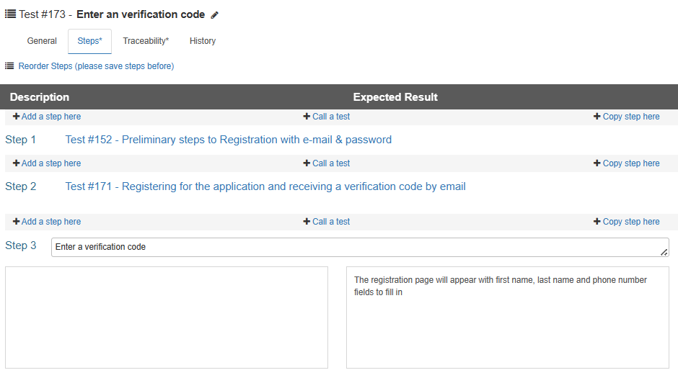

Slide 32
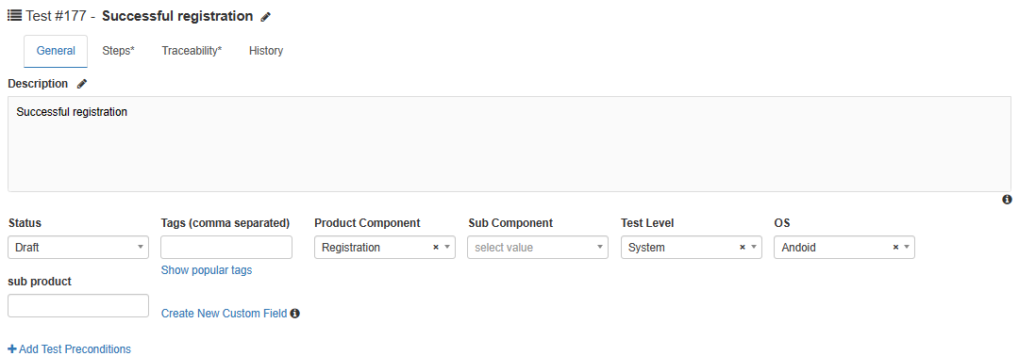
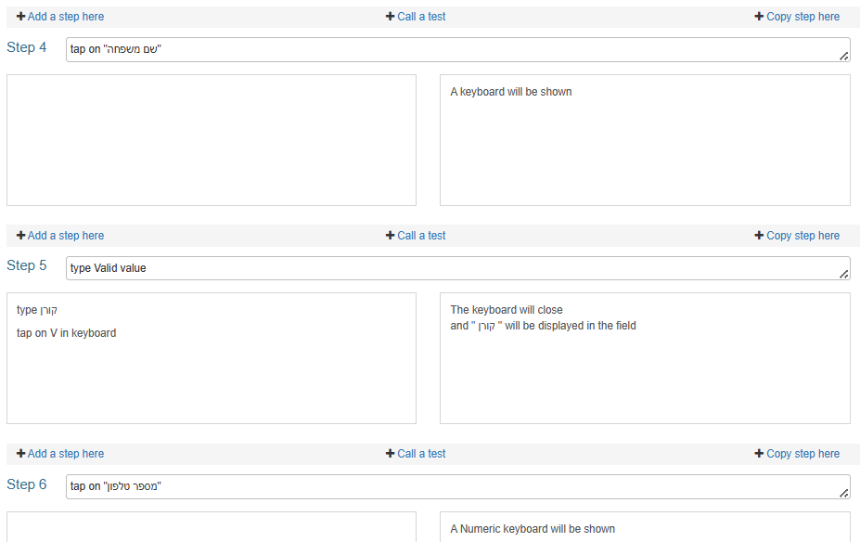
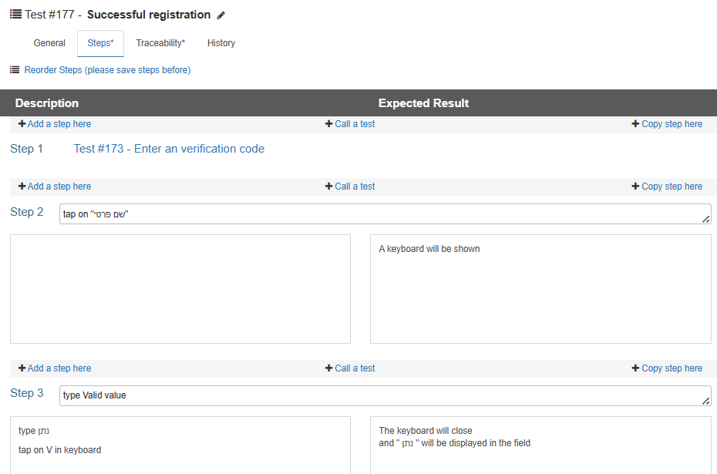
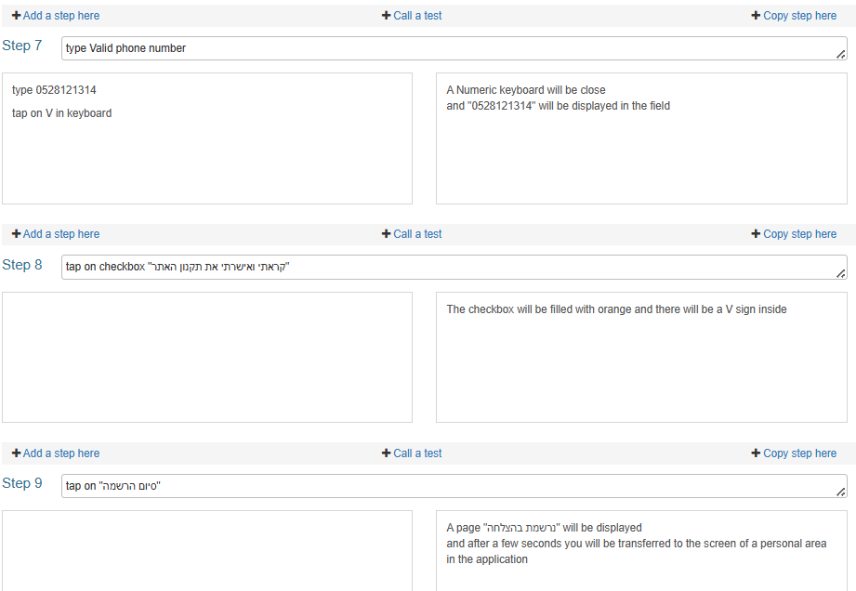

Slide 33
Natan Koren issues
The following Issues will be presented in the following slides:
Issue #3 - A scrolling panel with Types, display results do not match the selected department
Issue #8 - At the stage of uploading a photo, the window requesting device permissions for gallery does not open

Slide 34
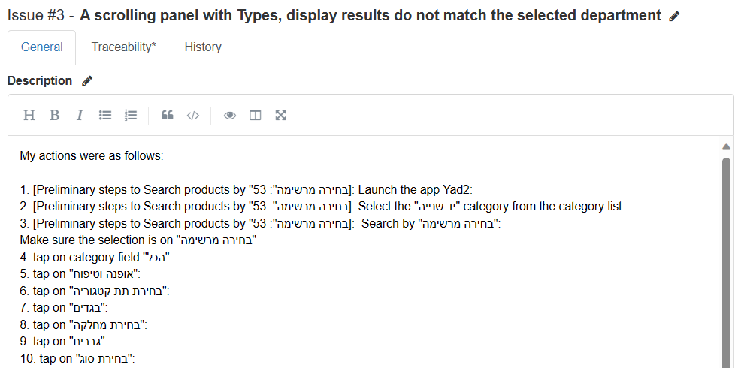

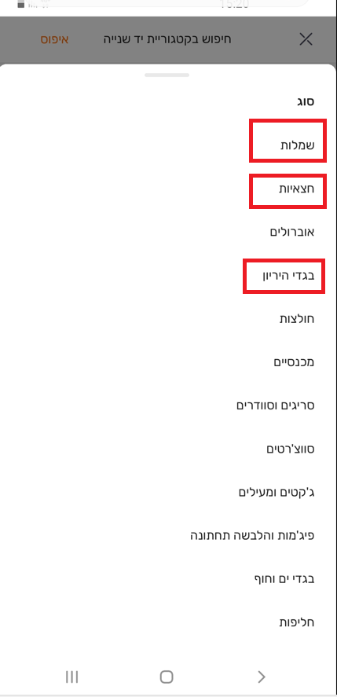
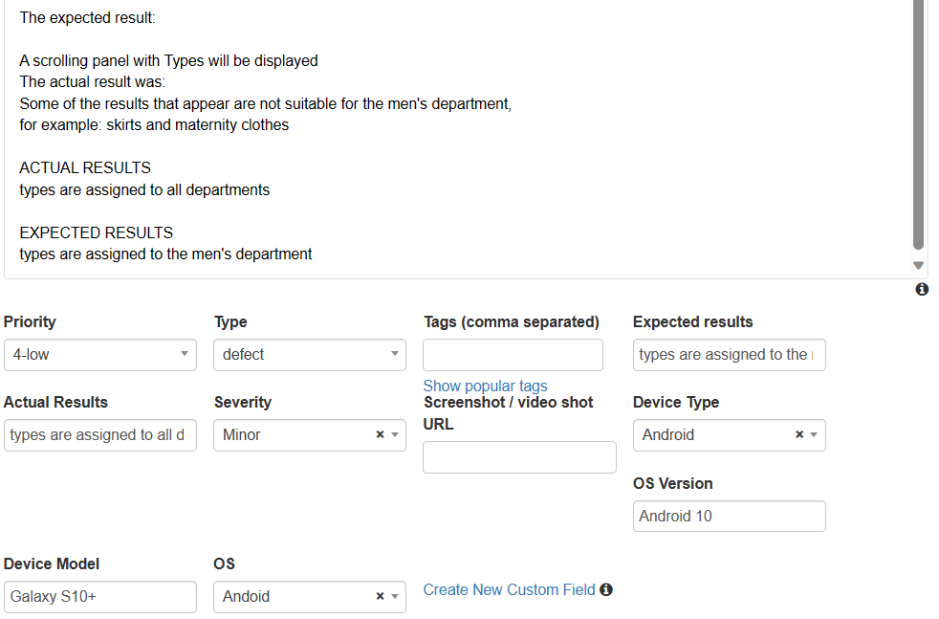
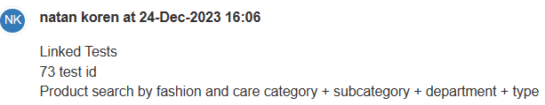

Slide 35







Slide 36




Link to STR Document

